Slide 1
Enum Generic lambda
POLARIS SLIDE
Enjoy your stylish business and campus life with BIZCAM

Slide 2
POLARIS SLIDE
Enjoy your stylish business and campus life with BIZCAM
Enum
Constant
관련 상수들의 집합
명시적
약속

Slide 3
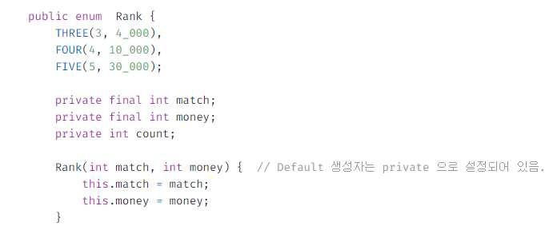
POLARIS SLIDE
Enjoy your stylish business and campus life with BIZCAM
Enum
클래스를 상수처럼 사용할 수 있다

Slide 4
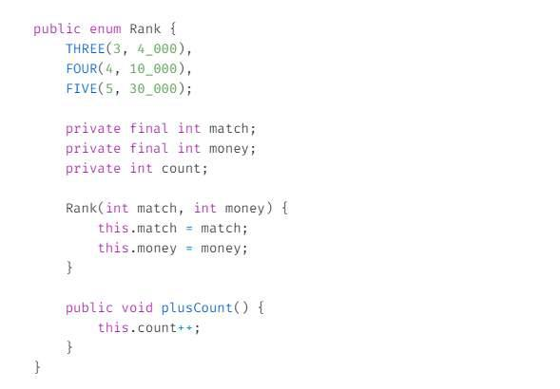
POLARIS SLIDE
Enjoy your stylish business and campus life with BIZCAM
Enum
상수 값과 같이 유일하게 하나의 인스턴스가 생성

Slide 5
POLARIS SLIDE
Enjoy your stylish business and campus life with BIZCAM
Enum
서로 관련있는 상수를 모아서 Enum으로 만듦
클래스와 같은 문법 체계를 따름
상속을 지원하지 않는다

Slide 6
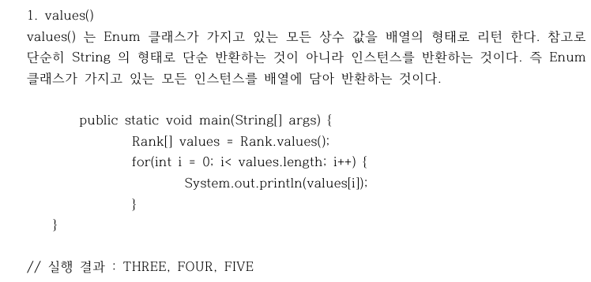
POLARIS SLIDE
Enjoy your stylish business and campus life with BIZCAM
Enum

Slide 7
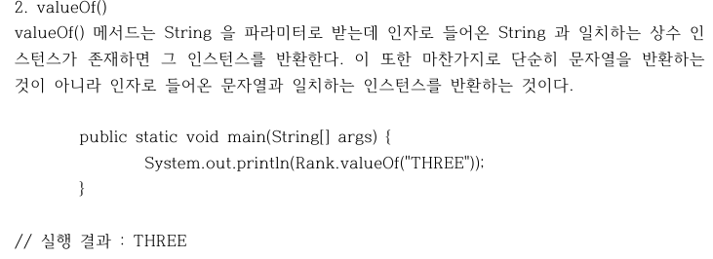
POLARIS SLIDE
Enjoy your stylish business and campus life with BIZCAM
Enum

Slide 8

POLARIS SLIDE
Enjoy your stylish business and campus life with BIZCAM
Enum

Slide 9
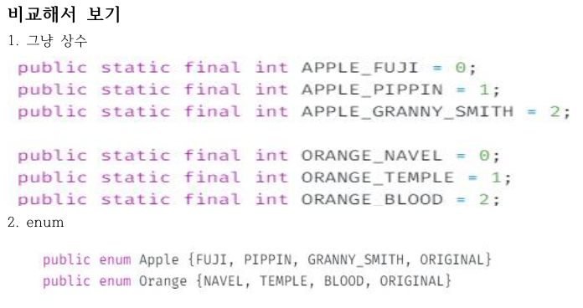
POLARIS SLIDE
Enjoy your stylish business and campus life with BIZCAM
Enum

Slide 10
POLARIS SLIDE
Enjoy your stylish business and campus life with BIZCAM
Generic
<T> <K,V> <E>
JDK 1.5
Vs Object
데이터 타입 외부 지정

Slide 11

POLARIS SLIDE
Enjoy your stylish business and campus life with BIZCAM
Generic
님들 맨날 쓰고있음;

Slide 12
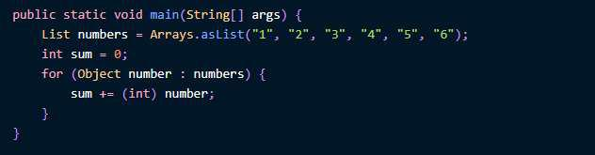
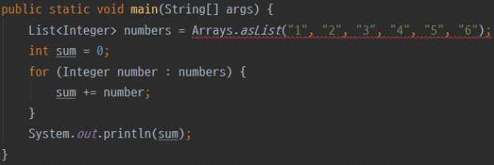
POLARIS SLIDE
Enjoy your stylish business and campus life with BIZCAM
Generic
이걸 왜 쓰냐고?

Slide 13
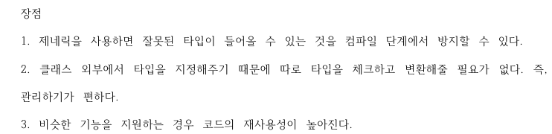
POLARIS SLIDE
Enjoy your stylish business and campus life with BIZCAM
Generic

Slide 14
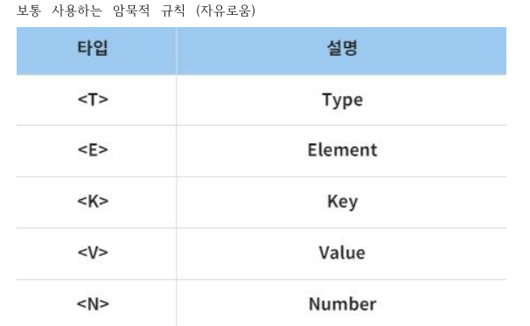
POLARIS SLIDE
Enjoy your stylish business and campus life with BIZCAM
Generic

Slide 15
POLARIS SLIDE
Enjoy your stylish business and campus life with BIZCAM
Generic
TEST

Slide 16
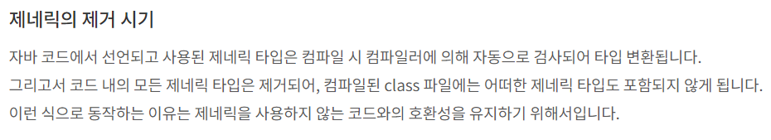
POLARIS SLIDE
Enjoy your stylish business and campus life with BIZCAM
Generic

Slide 17
POLARIS SLIDE
Enjoy your stylish business and campus life with BIZCAM
Lambda
Anonymous
간결
단순
깔끔

Slide 18
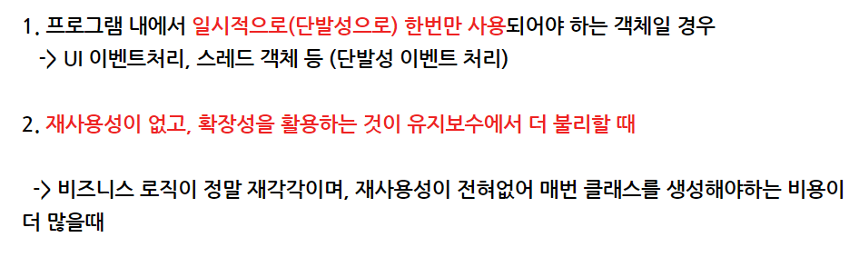
POLARIS SLIDE
Enjoy your stylish business and campus life with BIZCAM
Lambda
Anonymous

Slide 19
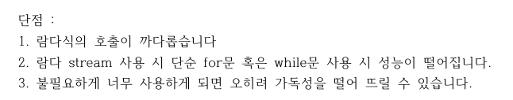
POLARIS SLIDE
Enjoy your stylish business and campus life with BIZCAM
Lambda

Slide 20
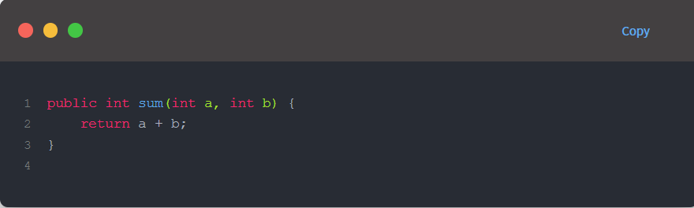
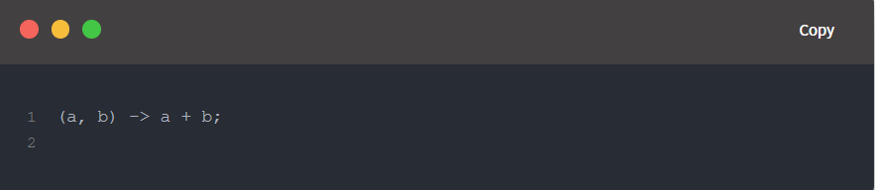
POLARIS SLIDE
Enjoy your stylish business and campus life with BIZCAM
Lambda

Slide 21
끝 ;
POLARIS SLIDE
Enjoy your stylish business and campus life with BIZCAM

